Slide 1
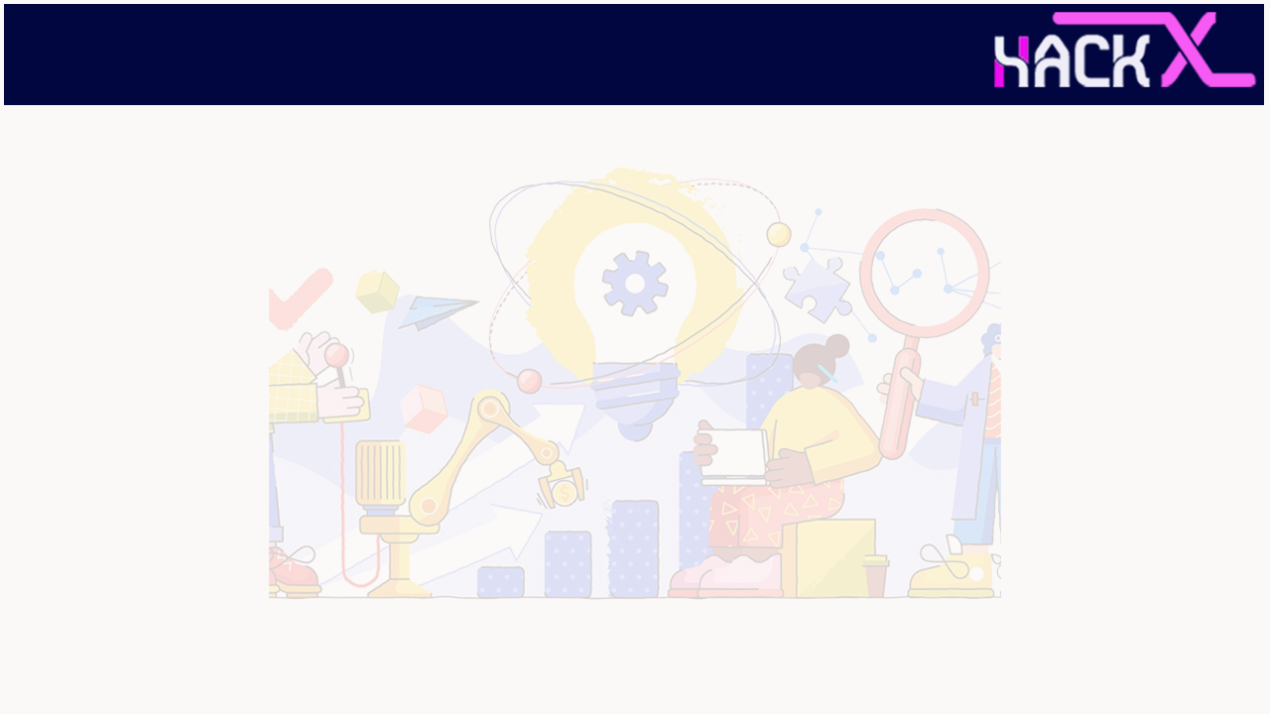

SLIDE 1
team- predictive insights
Team members:
Ankit Yadav [Leader]
8545859279
Ayush Srivastava
6387103331
Siddharth Singh
6306362938
Domain name : open innovation
Problem statement : In such unprecedented times, with a fragile healthcare infrastructure, the medical facilities for people are scarce and even fewer for people with special needs. The healthcare sector got so pre-occupied with Covid-19 cases that people with
other ailments didn't even get a chance to avail medical assistance.

Slide 2
SLIDE 2
ABSTRACT
The health problem is the gap between an acceptable or desirable health status and the current status.
To develop machine learning model to predict future possibility of disease by implementing suitable Machine Learning Algorithms.
Integration of clinical decision support with computer-based patient records could reduce medical errors, enhance patient safety, decease unwanted practice variation and improve practice outcome which can help significantly improve the quality of clinical decisions
to develop an Intelligent Diagnosis System using the data mining modelling technique & Integrate doctors and patients via interacting and user-friendly interface so that Patient can easily utilize in emergency situations.

Slide 3
SLIDE 3
NOVELTY
The project is based on real time implementation as well as more informative and realistic it can be highly used in Medical Diagnosis and understanding the different feasibilities of model. Generally, give the wider view of knowledge and highly impactive to the mind
The system proposed was developed to classify people with suffering from Diseases and healthy individuals. The efficiency of various predictive models for the diagnosis of disease have been evaluated on complete and selected apps. The commonly used computer modules generate a detailed report using a powerful predictor algorithm that give highly accurate model regarding patient safety.
The main goals of the present framework are to evaluate and test patients with condition results and new patient diseases in order to evaluate the potential for a particular person to develop any type of disorder.

Slide 4
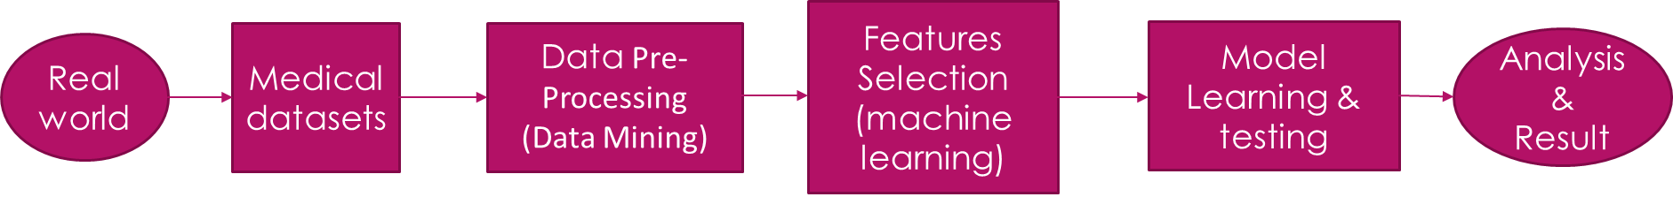
SLIDE 4
DOCTOR Module
PATIENT Module
view all patient details and their medical history
Register and upload details
Collect and Check all attributes of patients
If already registered, view and update details
The result is display on a screen whether the person is suffering or not from any diseases.
Get consultation based on the result
After result give proper advice to patients
In emergency situation, give instant treatment methods at anywhere by own.

Slide 5
SLIDE 5
Augmented Diagnosis
We have observed that some patients find it challenging to describe their symptoms to doctors accurately.
Using AR, patients will be able to express their symptoms better. The process will make it easier for doctors to determine their patient’s symptoms and accurately diagnose them.
When patients not able to the hospital, then how patients able to access any doctor appointment & how doctor manage to give action according to patient health.

Slide 6
SLIDE 6
TECHNOLOGY STACK
Web Development
VS Code, HTML, CSS, ReactJS, Django etc.
Augmented Reality
Unity, Vuforia SDK, AR Core, A Frame, JDK, Augmented Reality integrated with Machine Learning
Machine Learning
Anaconda, Jupyter Notebook, EDA,Data Collection, Cleaning, Visualisation, NumPy, Pandas, Seaborn, SciPy, Matplotlib, Pandas, Sklearn Libraries, ML Algorithms.

Slide 7
SLIDE 7
Social Impact Analysis
Integration of clinical decision support with computer-based patient records could reduce medical errors, enhance patient safety.
It deceases unwanted practice variation and improve practice outcome which can help significantly improve the quality of clinical decisions.
Reduce disease identification time and start treatment expeditiously.
Reduce the cost of medical tests & by providing initial diagnostics in time that reduce huge amount of burden on patient’s family.

Slide 8
SLIDE 8
BUSINESS SCOPE
It can be easily implementable because in this pandemic period most of peoples are technically advanced & they are mostly relies on the internet.
It can be widely spread on different Social media platforms, Application based platforms like google play store, Appstore etc.
It can be easily accessed & modified.

